Slide 1

Year 5
Key Instant Recall Facts (KIRFs)
To help develop children’s fluency in mathematics, we ask them to learn Key Instant Recall Facts (KIRFs) each half term. We suggest children practise their KIRFs at least 3 times a week to build fluency and confidence.
The lists of KIRFs align with the National Curriculum for Maths. They are intended to be aspirational and encourage children to be confident mathematicians.

Slide 2
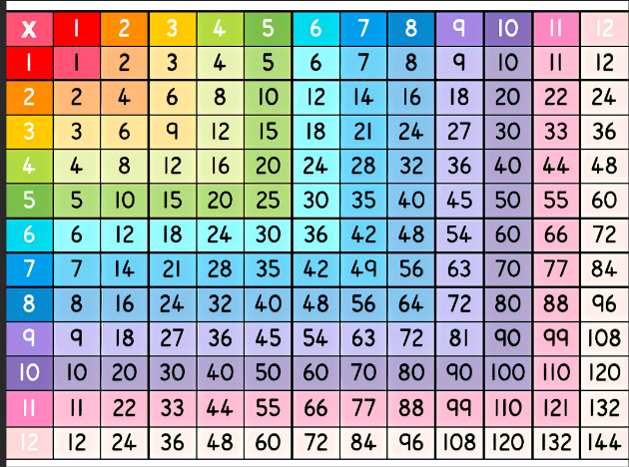

Year 5 – Autumn 1
I know the multiplication and division facts for all times tables up to 12 × 12 – focus on 3, 6, 4 and 8.
Please see separate sheet for all times table facts.
Key Vocabulary
What is 12 multiplied by 6?
What is 7 times 8?
What is 32 divided by 4?
They should be able to answer these questions in any order, including missing number questions e.g. 7 × ⃝ = 28 or ⃝ ÷ 6 = 7.
Top Tips
The secret to success is practising little and often. Use time wisely. Can you practise these KIRFs while walking to school or during a car journey? You don’t need to practise them all at once: perhaps you could have a fact family of the day. If you would like more ideas, please speak to your child’s teacher.
Speed Challenge – Take two packs of playing cards and remove the kings. Turn over two cards and ask your child to multiply the numbers together (Ace = 1, Jack = 11, Queen = 12). How many questions can they answer correctly in 2 minutes? Practise regularly and see if they can beat their high score.
Times Table Rock Stars – Your child will be able to access their own personal account at
Use memory tricks – For those hard-to-remember facts, www.multiplication.com has some strange picture stories to help children remember.

Slide 3
Year 5 – Autumn 2
I know the multiplication and division facts for all times tables up to 12 × 12 –focus on 7, 9, 11 and 12 .
Key Vocabulary
What is 12 multiplied by 6?
What is 7 times 8?
What is 84 divided by 7?
They should be able to answer these questions in any order, including missing number questions e.g. 7 × ⃝ = 28 or ⃝ ÷ 6 = 7.
Top Tips
The secret to success is practising little and often. Use time wisely. Can you practise these KIRFs while walking to school or during a car journey? You don’t need to practise them all at once: perhaps you could have a fact family of the day. If you would like more ideas, please speak to your child’s teacher.
Speed Challenge – Take two packs of playing cards and remove the kings. Turn over two cards and ask your child to multiply the numbers together (Ace = 1, Jack = 11, Queen = 12). How many questions can they answer correctly in 2 minutes? Practise regularly and see if they can beat their high score.
Times Table Rock Stars – Your child will be able to access their own personal account at
Use memory tricks – For those hard-to-remember facts, www.multiplication.com has some strange picture stories to help children remember.

Slide 4
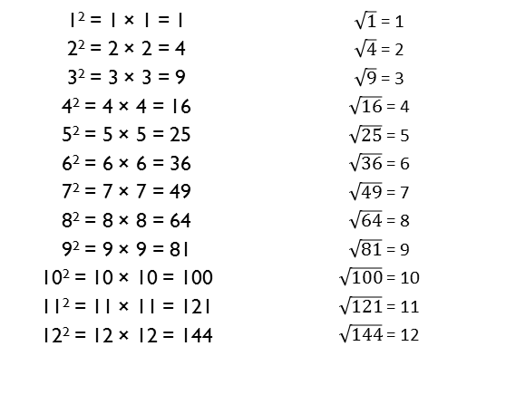
Year 5 – Spring 1
I can recall square numbers up to 12² and their square roots.
1² = 1 × 1 = 1 2² = 2 × 2 = 4 3² = 3 × 3 = 9 4² = 4 × 4 = 16 5² = 5 × 5 = 25 6² = 6 × 6 = 36 7² = 7 × 7 = 49 8² = 8 × 8 = 64 9² = 9 × 9 = 81 10² = 10 × 10 = 100 11² = 11 × 11 = 121 12² = 12 × 12 = 144 | $\sqrt{1}$ = 1 $\sqrt{4}$ = 2 $\sqrt{9}$ = 3 $\sqrt{16}$ = 4 $\sqrt{25}$ = 5 $\sqrt{36}$ = 6 $\sqrt{49}$ = 7 $\sqrt{64}$ = 8 $\sqrt{81}$ = 9 $\sqrt{100}$ = 10 $\sqrt{121}$ = 11 $\sqrt{144}$ = 12
Key Vocabulary
What is 8 squared?
What is 7 multiplied by itself?
What is the square root of 144?
Is 81 a square number?
Children should also be able to recognise whether a number below 150 is a square number or not.
Top Tips
The secret to success is practising little and often. Use time wisely. Can you practise these KIRFs while walking to school or during a car journey? You don’t need to practise them all at once: perhaps you could have a fact of the day. If you would like more ideas, please speak to your child’s teacher.
Cycling Squares – At http://nrich.maths.org/1151 there is a challenge involving square numbers. Can you complete the challenge and then create your own examples?
Use memory tricks – For those hard-to-remember facts, www.multiplication.com has some strange picture stories to help children remember.

Slide 5
Year 5 – Spring 2
I can identify prime numbers up to 20.
A prime number is a number with no factors other than itself and one.
The following numbers are prime numbers:
2, 3, 5, 7, 11, 13, 17, 19
A composite number is divisible by a number other than 1 or itself.
The following numbers are composite numbers:
4, 6, 8, 9, 10, 12, 14, 15, 16, 18, 20
Key Vocabulary
prime number
composite number
factor
multiple
Children should be able to explain how they know that a number is composite.
E.g. 15 is composite because it is a multiple of 3 and 5.
Top Tips
The secret to success is practising little and often. Use time wisely. Can you practise these KIRFs while walking to school or during a car journey? You don’t need to practise them all at once: perhaps you could have a fact of the day. If you would like more ideas, please speak to your child’s teacher.
It’s really important that your child uses mathematical vocabulary accurately. Choose a number between 2 and 20. How many correct statements can your child make about this number using the vocabulary above?
Make a set of cards for the numbers from 2 to 20. How quickly can your child sort these into prime and composite numbers? How many even prime numbers can they find? How many odd composite numbers?

Slide 6
Year 5 – Summer 1
I know decimal number bonds to 1 and 10.
Some examples: 0.6 + 0.4 = 1 0.4 + 0.6 = 1 1 – 0.4 = 0.6 1– 0.6 = 0.4 0.75 + 0.25 = 1 0.25 + 0.75 = 1 1 – 0.25 = 0.75 1 – 0.75 = 0.25 | 3.7 + 6.3 = 10 6.3 + 3.7 = 10 10 – 6.3 = 3.7 10 – 3.7 = 6.3 4.8 + 5.2 = 10 5.2 + 4.8 = 10 10 – 5.2 = 4.8 10 – 4.8 = 5.2
Key Vocabulary
What do I add to 0.8 to make 1?
What is 1 take away 0.06?
What is 1.3 less than 10?
How many more than 9.8 is 10?
What is the difference between 0.92 and 10?
This list includes some examples of facts that children should know. They should be able to answer questions including missing number questions e.g. 0.49 + ⃝ = 10 or 7.2 + ⃝ = 10.
Top Tips
The secret to success is practising little and often. Use time wisely. Can you practise these KIRFs while walking to school or during a car journey? You don’t need to practise them all at once: perhaps you could have a fact of the day. If you would like more ideas, please speak to your child’s teacher.
Buy one get three free - If your child knows one fact (e.g. 8 + 5 = 13), can they tell you the other three facts in the same fact family?
Use number bonds to 10 - How can number bonds to 10 help you work out number bonds to 100?

Slide 7
Year 5 – Summer 2
I can recall metric conversions.
1 kilogram = 1000 grams
1 kilometre = 1000 metres
1 metre = 100 centimetres
1 metre = 1000 millimetres
1 centimetre = 10 millimetres
1 litre = 1000 millilitres
They should also be able to apply these facts to answer questions.
e.g. How many metres in 1½ km?
Top Tips
The secret to success is practising little and often. Use time wisely. Can you practise these KIRFs while walking to school or during a car journey? You don’t need to practise them all at once: perhaps you could have a fact of the day. If you would like more ideas, please speak to your child’s teacher.
Look at the prefixes – Can your child work out the meanings of kilo-, centi- and milli-? What other words begin with these prefixes?
Be practical – Do some baking and convert the measurements in the recipe.
How far? – Calculate some distances using unusual measurements. How tall is your child in mm? How far away is London in metres?

