Slide 1

Year 6
Key Instant Recall Facts (KIRFs)
To help develop children’s fluency in mathematics, we ask them to learn Key Instant Recall Facts (KIRFs) each half term. We suggest children practise their KIRFs at least 3 times a week to build fluency and confidence.
The lists of KIRFs align with the National Curriculum for Maths. They are intended to be aspirational and encourage children to be confident mathematicians.
Please note, there is no KIRF for Year 6 in the Summer term.

Slide 2

Year 6 – Autumn 1
I know the multiplication and division facts for all times tables up to 12 × 12 .
Please see separate sheet for all times table facts.
This is a chance for Year 6 children to consolidate their knowledge of multiplication and division facts and to increase their speed of recall.
Key Vocabulary
What is 12 multiplied by 6?
What is 7 times 8?
What is 84 divided by 7?
They should be able to answer these questions in any order, including missing number questions e.g. 7 × ⃝ = 28 or ⃝ ÷ 6 = 7.
Children who have already mastered their times tables should apply this knowledge to answer questions including decimals e.g. 0.7 × ⃝ = 4.2 or ⃝ ÷ 60 = 0.7
Top Tips
The secret to success is practising little and often. Use time wisely. Can you practise these KIRFs while walking to school or during a car journey? You don’t need to practise them all at once: perhaps you could have a fact family of the day. If you would like more ideas, please speak to your child’s teacher.
Speed Challenge – Take two packs of playing cards and remove the kings. Turn over two cards and ask your child to multiply the numbers together (Ace = 1, Jack = 11, Queen = 12). How many questions can they answer correctly in 2 minutes? Practise regularly and see if they can beat their high score.
Times Table Rock Stars – Your child will be able to access their own personal account at
Use memory tricks – For those hard-to-remember facts, www.multiplication.com has some strange picture stories to help children remember.

Slide 3
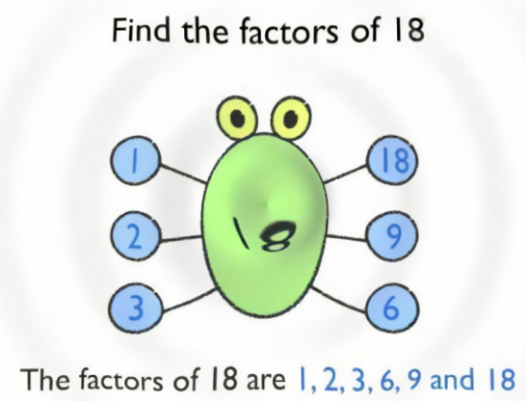
Year 6 – Autumn 2
I can identify common factors of a pair of numbers.
The factors of a number are all numbers which divide it with no remainder.
E.g. the factors of 24 are 1, 2, 3, 4, 6, 8, 12, and 24. The factors of 56 are 1, 2, 4, 7, 8, 14, 28 and 56.
The common factors of two numbers are the factors they share.
E.g. the common factors of 24 and 56 are 1, 2, 4 and 8.
The greatest common factor of 24 and 56 is 8.
Key Vocabulary
factor
common factor
multiple
greatest common factor
Children should be able to explain how they know that a number is a common factor.
E.g. 8 is a common factor of 24 and 56 because 24 = 8 × 3 and 56 = 8 × 7.
Top Tips
The secret to success is practising little and often. Use time wisely. Can you practise these KIRFs while walking to school or during a car journey? If your child is not yet confident with identifying factor pairs of a number, you may want to refer to the Year 5 Summer 2 sheet to practise this first. If you would like more ideas, please speak to your child’s teacher.
There are many online games to practise finding the greatest common factor, for example:
http://www.fun4thebrain.com/beyondfacts/gcfsketch.html
Choose two numbers.
Take it in turns to name factors.
Who can find the most?

Slide 4
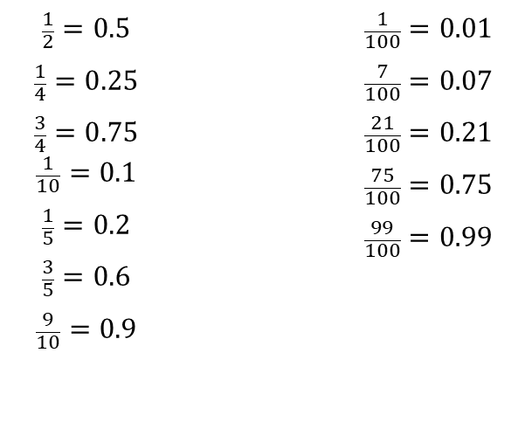
Year 6 – Spring 1
I can convert between decimals, fractions and percentages.
$$\frac{1}{2}=0.5$$ $$\frac{1}{4}=0.25$$ $$\frac{3}{4}=0.75$$ $$\frac{1}{10}=0.1$$ $$\frac{1}{5}=0.2$$ $$\frac{3}{5}=0.6$$ $$\frac{9}{10}=0.9$$ |  | $$\frac{1}{100}=0.01$$ $$\frac{7}{100}=0.07$$ $$\frac{21}{100}=0.21$$ $$\frac{75}{100}=0.75$$ $$\frac{99}{100}=0.99$$
Key Vocabulary
How many tenths is 0.8?
How many hundredths is 0.12?
Write 0.75 as a fraction?
Write ¼ as a decimal?
Children should be able to convert between decimals and fractions for ½, ¼, ¾ and any number of tenths and hundredths.
Top Tips
The secret to success is practising little and often. Use time wisely. Can you practise these KIRFs while walking to school or during a car journey? You don’t need to practise them all at once: start with tenths before moving on to hundredths. If you would like more ideas, please speak to your child’s teacher.
Play games - Make some cards with pairs of equivalent fractions and decimals. Use these to play the memory game or snap. Or make your own dominoes with fractions on one side and decimals on the other.

Slide 5
Year 6 – Spring 2
I can identify prime numbers up to 50.
A prime number is a number with no factors other than itself and one.
The following numbers are prime numbers:
2, 3, 5, 7, 11, 13, 17, 19, 23,
29, 31, 37, 41, 43, 47
A composite number is divisible by a number other than 1 or itself.
The following numbers are composite numbers:
4, 6, 8, 9, 10, 12, 14, 15, 16, 18, 20,
22, 24, 25, 26, 27, 28, 30, 32, 34, 35, 36,
38, 39, 40, 42, 44, 45, 46, 48, 49, 50
Key Vocabulary
prime number
composite number
factor
multiple
Children should be able to explain how they know that a number is composite.
E.g. 39 is composite because it is a multiple of 3 and 13.
Top Tips
The secret to success is practising little and often. Use time wisely. Can you practise these KIRFs while walking to school or during a car journey? You don’t need to practise them all at once: perhaps you could have a fact of the day. If you would like more ideas, please speak to your child’s teacher.
It’s really important that your child uses mathematical vocabulary accurately. Choose a number between 2 and 50. How many correct statements can your child make about this number using the vocabulary above?
Make a set of cards for the numbers from 2 to 50. How quickly can your child sort these into prime and composite numbers? How many even prime numbers can they find? How many odd composite numbers?

