Slide 1

Year 1
Key Instant Recall Facts (KIRFs)
To help develop children’s fluency in mathematics, we ask them to learn Key Instant Recall Facts (KIRFs) each half term. We suggest children practise their KIRFs at least 3 times a week to build fluency and confidence.
The lists of KIRFs align with the National Curriculum for Maths. They are intended to be aspirational and encourage children to be confident mathematicians.
Please note, there is no KIRF for Year 1 in the first Autumn half term.

Slide 2
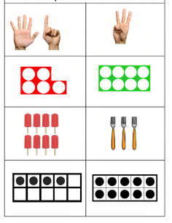
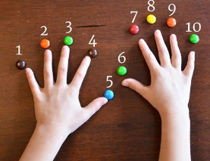

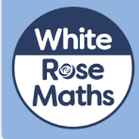
Year 1 – Autumn 1
I can count forwards and backwards from 0 - 10
0 1 2 3 4 5 6 7 8 9 10
Top Tips
The secret to success is practising little and often. Can you practise these KIRFs while walking to school or during a car journey? You don’t need to practise them all at once: perhaps you could have a fact of the day. If you would like more ideas, please speak to your child’s teacher.
Use practical resources – Your child has one potato on their plate and you give them three more. Can they predict how many they will have now? You count down from 10 to launch a rocket toy.
Make a poster – Your child could make a poster with 10 items to count.
Play games –1-minute maths app (free) is a great app to support counting. There are also great games on IXL.

Slide 3
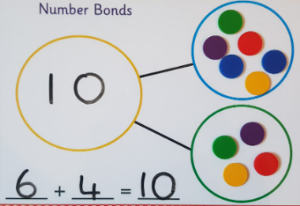
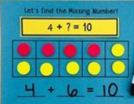
Year 1 – Autumn 2
I know number bonds to 10.
0 + 10 = 10 10 + 0 = 10 10 – 10 = 0 10 – 0 = 10 1 + 9 = 10 9 + 1 = 10 10 – 9 = 1 10 – 1 = 9 | 2 + 8 = 10 8 + 2 = 10 10 – 8 = 2 10 – 2 = 8 3 + 7 = 10 7 + 3 = 10 10 – 7 = 3 10 – 3 = 7 | 4 + 6 = 10 6 + 4 = 10 10 – 6 = 4 10 – 4 = 6 5 + 5 = 10 10 – 5 = 5
Key Vocabulary
What is 3 add 2?
What is 2 plus 2?
What is 5 take away 2?
What is 1 less than 4?
They should be able to answer these questions in any order, including missing number questions e.g. 6 + ⃝ = 10 or 10 – ⃝ = 3.
Top Tips
The secret to success is practising little and often. Can you practise these KIRFs while walking to school or during a car journey? You don’t need to practise them all at once: perhaps you could have a fact of the day. If you would like more ideas, please speak to your child’s teacher.
Use practical resources on a part whole model or ten frame
Practise online – There are many great games including on 1-minute maths and IXL maths.

Slide 4
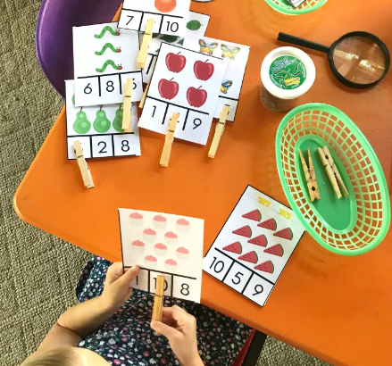
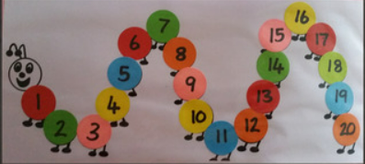
Year 1 – Spring 1
I can count forwards and backwards from 0 - 20
0 1 2 3 4 5 6 7 8 9 10 | 11 12 13 14 15 16 17 18 19 20
Top Tips
The secret to success is practising little and often. Can you practise these KIRFs while walking to school or during a car journey? You don’t need to practise them all at once: perhaps you could have a fact of the day. If you would like more ideas, please speak to your child’s teacher.
Songs – There are some great songs to count along to such as The Singing Walrus on Youtube. Check the accuracy of your child when they say the teen numbers . For example 18 not 80.
Use practical resources – Use natural resources like pine cones or sticks to count forwards and backwards 1s to 20. Use lego to build it, count it and write numbers.
Play games – You can play games on IXL including 20 Rekenrek and Bud’s number garden.

Slide 5
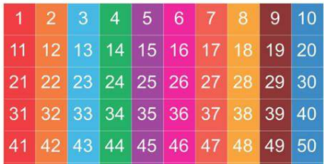
Year 1 – Spring 2
I can count to 50
Key Vocabulary
What number is before 27?
What number is after 39?
Is 13 or 31 bigger?
Make 45 using resources
Top Tips
The secret to success is practising little and often. Can you practise these KIRFs while walking to school or during a car journey? You don’t need to practise them all at once: perhaps you could have a fact of the day. If you would like more ideas, please speak to your child’s teacher.
Use crafts and practical resources– Use craft materials, natural materials or toys to build up children’s interest in counting. Count out 50 pieces of dry pasta to paint and thread onto wool to make a garland. Count out marbles then create a pattern. Use 50 lego pieces to build a model.
Play games – Games such as fastest finger, snakes and ladders and number twister are great ways to bring learning and fun together.
Practise online – There are many great games including on 1-minute maths and IXL maths.

Slide 6
Year 1 – Summer 1
I can count in 2s, 5s, and 10s
0 2 4 6 8 10 12 14 16 18 20 22 24 | 0 5 10 15 20 25 30 35 40 45 50 55 60 | 0 10 20 30 40 50 60 70 80 90 100 110 120
Key Vocabulary
Can you spot a pattern when counting in 5s?
Can you spot a pattern when counting in 100s?
Will I say an odd number when counting in 2s? How do you know?
Top Tips
The secret to success is practising little and often. Can you practise these KIRFs while walking to school or during a car journey? You don’t need to practise them all at once: perhaps you could have a fact of the day. If you would like more ideas, please speak to your child’s teacher.
Crafts – create your own number lines with paper and paint. Hand prints to count in 5s, 2 handprints for 10s, 2 footprints for counting in 2s.
Play games – bean bag targets with 2 points, 5 points and 10 points for different hula hoop targets.
Practise online – There are many great games including on 1-minute maths and IXL maths.

Slide 7
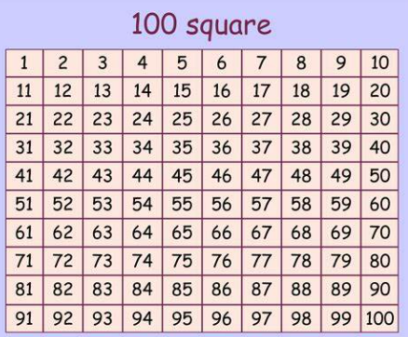
Year 1 – Summer 2
I can count to and across 100, forwards and back from 0, 1 and any given number
Key Vocabulary
What number is after 49?
What number is before 90?
What number is after 99?
Top Tips
The secret to success is practising little and often. Can you practise these KIRFs while walking to school or during a car journey? You don’t need to practise them all at once: perhaps you could have a fact of the day. If you would like more ideas, please speak to your child’s teacher.
Play games – Games such as snakes and ladders are great at promoting counting.
Practise online – There are many great games including on 1-minute maths and IXL maths such as place value basketball and shark numbers.

