Slide 1

Year 4
Key Instant Recall Facts (KIRFs)
To help develop children’s fluency in mathematics, we ask them to learn Key Instant Recall Facts (KIRFs) each half term. We suggest children practise their KIRFs at least 3 times a week to build fluency and confidence.
The lists of KIRFs align with the National Curriculum for Maths. They are intended to be aspirational and encourage children to be confident mathematicians.

Slide 2

Year 4 – Autumn 1
I know the multiplication and division facts for the 3, 4 and 8 times table.
3 | 4 | 8
1x3=3 | 1x4=4 | 1x8=8
2x3=6 | 2x4=8 | 2x8=16
3x3=9 | 3x4=12 | 3x8=24
4x3=12 | 4x4=16 | 4x8=32
5x3=15 | 5x4=20 | 5x8=40
6x3=18 | 6x4=24 | 6x8=48
7x3=21 | 7x4=28 | 7x8=56
8x3=24 | 8x4=32 | 8x8=64
9x3=27 | 9x4=36 | 9x8=72
10x3=30 | 10x4=40 | 10x8=80
11x3=33 | 11x4=44 | 11x8=88
12x3=36 | 12x4=48 | 12x8=96
Key Vocabulary
What is 8 multiplied by 6?
What is 6 times 8?
What is 24 divided by 6?
Top Tips
The secret to success is practising little and often. Use time wisely. Can you practise these KIRFs while walking to school or during a car journey? You don’t need to practise them all at once: perhaps you could have a fact family of the day. If you would like more ideas, please speak to your child’s teacher.
Songs and Chants – You can buy Times Tables CDs or find multiplication songs and chants online. If your child creates their own song, this can make the times tables even more memorable.
Double your threes – Multiplying a number by 6 is the same as multiplying by 3 and then doubling the answer. 7 × 3 = 21 and double 21 is 42, so 7 × 6 = 42.
Buy one get three free – If your child knows one fact (e.g. 3 × 6 = 18), can they tell you the other three facts in the same fact family?
Warning! – When creating fact families, children sometimes get confused by the order of the numbers in the division number sentence. It is tempting to say that the biggest number goes first, but it is more helpful to say dividend to describe the number that is divided. E.g. 72 ÷ 12 = 6 the dividend is 72.
Times Table Rock Stars – Your child will be able to access their own personal account at

Slide 3
Year 4 – Autumn 2
I know the multiplication and division facts for the 6 times table.
6 × 1 = 6 6 × 2 = 12 6 × 3 = 18 6 × 4 = 24 6 × 5 = 30 6 × 6 = 36 6 × 7 = 42 6 × 8 = 48 6 × 9 = 54 6 × 10 = 60 6 × 11 = 66 6 × 12 = 72 | 1 × 6 = 6 2 × 6 = 12 3 × 6 = 18 4 × 6 = 24 5 × 6 = 30 6 × 6 = 36 7 × 6 = 42 8 × 6 = 48 9 × 6 = 54 10 × 6 = 60 11 × 6 = 66 12 × 6 = 72 | 6 ÷ 6 = 1 12 ÷ 6 = 2 18 ÷ 6 = 3 24 ÷ 6 = 4 30 ÷ 6 = 5 36 ÷ 6 = 6 42 ÷ 6 = 7 48 ÷ 6 = 8 54 ÷ 6 = 9 60 ÷ 6 = 10 66 ÷ 6 = 11 72 ÷ 6 = 12 | 6 ÷ 1 = 6 12 ÷ 2 = 6 18 ÷ 3 = 6 24 ÷ 4 = 6 30 ÷ 5 = 6 36 ÷ 6 = 6 42 ÷ 7 = 6 48 ÷ 8 = 6 54 ÷ 9 = 6 60 ÷ 10 = 6 66 ÷ 11 = 6 72 ÷ 12 = 6
Key Vocabulary
What is 8 multiplied by 6?
What is 6 times 8?
What is 24 divided by 6?
They should be able to answer these questions in any order, including missing number questions e.g. 6 × ⃝ = 72 or ⃝ ÷ 6 = 7.
Top Tips
The secret to success is practising little and often. Use time wisely. Can you practise these KIRFs while walking to school or during a car journey? You don’t need to practise them all at once: perhaps you could have a fact family of the day. If you would like more ideas, please speak to your child’s teacher.
Songs and Chants – You can buy Times Tables CDs or find multiplication songs and chants online. If your child creates their own song, this can make the times tables even more memorable.
Double your threes – Multiplying a number by 6 is the same as multiplying by 3 and then doubling the answer. 7 × 3 = 21 and double 21 is 42, so 7 × 6 = 42.
Buy one get three free – If your child knows one fact (e.g. 3 × 6 = 18), can they tell you the other three facts in the same fact family?
Warning! – When creating fact families, children sometimes get confused by the order of the numbers in the division number sentence. It is tempting to say that the biggest number goes first, but it is more helpful to say dividend to describe the number that is divided. E.g. 72 ÷ 12 = 6 the dividend is 72.
Times Table Rock Stars – Your child will be able to access their own personal account at

Slide 4
Year 4 – Spring 1
I know the multiplication and division facts for the 9 and 11 times tables.
9 × 1 = 9 9 × 2 = 18 9 × 3 = 27 9 × 4 = 36 9 × 5 = 45 9 × 6 = 54 9 × 7 = 63 9 × 8 = 72 9 × 9 = 81 9 × 10 = 90 9 × 11 = 99 9 × 12 = 108 | 9 ÷ 9 = 1 18 ÷ 9 = 2 27 ÷ 9 = 3 36 ÷ 9 = 4 45 ÷ 9 = 5 54 ÷ 9 = 6 63 ÷ 9 = 7 72 ÷ 9 = 8 81 ÷ 9 = 9 90 ÷ 9 = 10 99 ÷ 9 = 11 108 ÷ 9 = 12 | 11 × 1 = 11 11 × 2 = 22 11 × 3 = 33 11 × 4 = 44 11 × 5 = 55 11 × 6 = 66 11 × 7 = 77 11 × 8 = 88 11 × 9 = 99 11×10 = 110 11×11 = 121 11×12 = 132 | 11 ÷ 11 = 1 22 ÷ 11 = 2 33 ÷ 11 = 3 44 ÷ 11 = 4 55 ÷ 11 = 5 66 ÷ 11 = 6 77 ÷ 11 = 7 88 ÷ 11 = 8 99 ÷ 11 = 9 110÷11 = 10 121÷11 = 11 132÷11 = 12
Key Vocabulary
What is 8 multiplied by 6?
What is 6 times 8?
What is 24 divided by 6?
They should be able to answer these questions in any order, including missing number questions e.g. 9 × ⃝ = 54 or ⃝ ÷ 9 = 11.
Top Tips
The secret to success is practising little and often. Use time wisely. Can you practise these KIRFs while walking to school or during a car journey? You don’t need to practise them all at once: perhaps you could have a fact family of the day. If you would like more ideas, please speak to your child’s teacher.
Look for patterns – These times tables are full of patterns for your child to find. How many can they spot?
Use your ten times table – Multiply a number by 10 and subtract the original number
(e.g. 7 × 10 – 7 = 70 – 7 = 63). What do you notice?
What happens if you add your original number instead?
(e.g. 7 × 10 + 7 = 70 + 7 = 77)
What do you already know? – Your child will already know many of these facts from the 2, 3, 4, 5, 6, 8 and 10 times tables. It might be worth practising these again!
Times Table Rock Stars – Your child will be able to access their own personal account at

Slide 5
Year 4 – Spring 2
I know the multiplication and division facts for the 7 and 12 times tables.
7 × 1 = 7 7 × 2 = 14 7 × 3 = 21 7 × 4 = 28 7 × 5 = 35 7 × 6 = 42 7 × 7 = 49 7 × 8 = 56 7 × 9 = 63 7 × 10 = 70 7 × 11 = 77 7 × 12 = 84 | 1 × 7 = 7 2 × 7 = 14 3 × 7 = 21 4 × 7 = 28 5 × 7 = 35 6 × 7 = 42 7 × 7 = 49 8 × 7 = 56 9 × 7 = 63 10 × 7 = 70 11 × 7 = 77 12 × 7 = 84 | 7 ÷ 7 = 1 14 ÷ 7 = 2 21 ÷ 7 = 3 28 ÷ 7 = 4 35 ÷ 7 = 5 42 ÷ 7 = 6 49 ÷ 7 = 7 56 ÷ 7 = 8 63 ÷ 7 = 9 70 ÷ 7 = 10 77 ÷ 7 = 11 84 ÷ 7 = 12 | 7 ÷ 1 = 7 14 ÷ 2 = 7 21 ÷ 3 = 7 28 ÷ 4 = 7 35 ÷ 5 = 7 42 ÷ 6 = 7 49 ÷ 7 = 7 56 ÷ 8 = 7 63 ÷ 9 = 7 70 ÷ 10 = 7 77 ÷ 11 = 7 84 ÷ 12 =7
Key Vocabulary
What is 7 multiplied by 6?
What is 7 times 8?
What is 84 divided by 7?
They should be able to answer these questions in any order, including missing number questions e.g. 7 × ⃝ = 28 or ⃝ ÷ 6 = 7.
Top Tips
The secret to success is practising little and often. Use time wisely. Can you practise these KIRFs while walking to school or during a car journey? You don’t need to practise them all at once: perhaps you could have a fact family of the day. If you would like more ideas, please speak to your child’s teacher.
Songs and Chants – You can buy Times Tables CDs or find multiplication songs and chants online. If your child creates their own song, this can make the times tables even more memorable.
Order of difficulty – Ask your child to order these facts from the easiest to the most challenging. Can they explain why some facts are easier to remember? Then focus on practising the most challenging facts.
Use memory tricks – For those hard-to-remember facts, www.multiplication.com has some strange picture stories to help children remember.
Times Table Rock Stars – Your child will be able to access their own personal account at

Slide 6
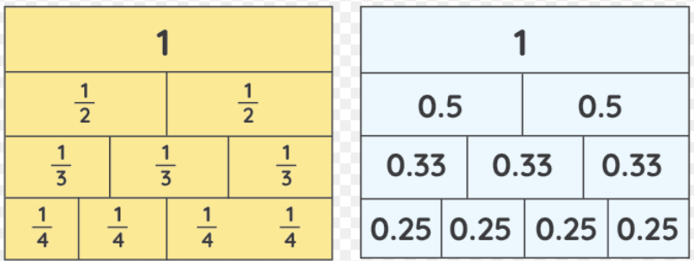
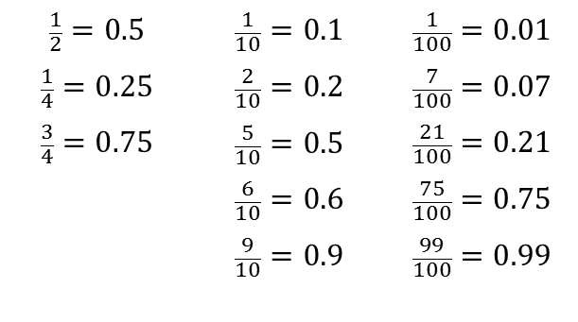
Year 4 – Summer 1
I can recognise decimal equivalents of fractions.
$$\frac{1}{2}=0.5$$ $$\frac{1}{4}=0.25$$ $$\frac{3}{4}=0.75$$ | $$\frac{1}{10}=0.1$$ $$\frac{2}{10}=0.2$$ $$\frac{5}{10}=0.5$$ $$\frac{6}{10}=0.6$$ $$\frac{9}{10}=0.9$$ | $$\frac{1}{100}=0.01$$ $$\frac{7}{100}=0.07$$ $$\frac{21}{100}=0.21$$ $$\frac{75}{100}=0.75$$ $$\frac{99}{100}=0.99$$
Key Vocabulary
How many tenths is 0.8?
How many hundredths is 0.12?
Write 0.75 as a fraction?
Write ¼ as a decimal?
Children should be able to convert between decimals and fractions for ½, ¼, ¾ and any number of tenths and hundredths.
Top Tips
The secret to success is practising little and often. Use time wisely. Can you practise these KIRFs while walking to school or during a car journey? You don’t need to practise them all at once: start with tenths before moving on to hundredths. If you would like more ideas, please speak to your child’s teacher.
Play games - Make some cards with pairs of equivalent fractions and decimals. Use these to play the memory game or snap. Or make your own dominoes with fractions on one side and decimals on the other.

Slide 7
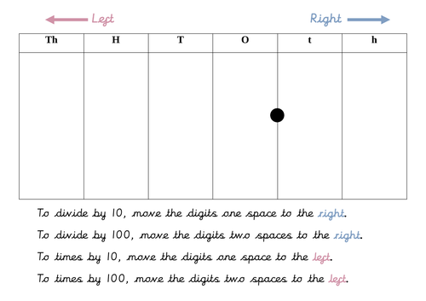
Year 4 – Summer 2
I can multiply and divide single-digit numbers by 10 and 100.
7 × 10 = 70 10 × 7 = 70 70 ÷ 7 = 10 70 ÷ 10 = 7 6 × 100 = 600 100 × 6 = 600 600 ÷ 6 = 100 600 ÷ 100 = 6 | 30 × 10 = 300 10 × 30 = 300 300 ÷ 30 = 10 300 ÷ 10 = 30 40 × 100 = 4000 100 × 40 = 4000 4000 ÷ 40 = 100 4000 ÷ 100 = 40 | 0.8 × 10 = 8 10 × 0.8 = 8 8 ÷ 0.8 = 10 8 ÷ 10 = 0.8 0.2 × 10 = 2 10 × 0.2 = 2 2 ÷ 0.2 = 10 2 ÷ 10 = 0.2
Key Vocabulary
What is 5 multiplied by 10?
What is 10 times 0.9?
What is 700 divided by 70?
hundreds, tens, units
tenths, hundredths
These are just examples of the facts for this term. Children should be able to answer these questions in any order, including missing number questions e.g. 10 × ⃝ = 5 or ⃝ ÷ 10 = 60.
Top Tips
Use a place value chart to support learning.

